Slide 2

Implementation of Client-Server Architecture in ‘C’
Submitted by Under the guidance of
PRATYUSH SHARMA (Enroll No. R103216072) Dr. T.P. SINGH
AYUSH CHATURVEDI (Enroll. No. R103216124) Associate Professor
SHUBHAM KUMAR (Enroll. No. R103216094)
SCHOOL OF COMPUTER SCIENCE
UNIVERSITY OF PETROLEUM & ENERGY STUDIES
Bidholi Campus, Energy Acres, Dehradun – 248007.
October – 2018
Notes:
We designed this template so that each member of the project team has a set of slides with its own theme. Members, here’s how you add a new slide to just your set:
Mark where you want to add the slide: Select an existing one in the Thumbnails pane, click the New Slide button, then choose a layout. The new slide gets the same theme as the other slides in your set.
Careful! Don’t annoy your fellow presenters by accidentally changing their themes. That can happen if you choose a different theme from the Design tab, which changes all of the slides in the presentation to that look.

Slide 3
Content
Abstract
Introduction
Problem statement
Objectives
Progress so far…
Methodology
Function Prototype
Screenshots

Slide 4
Abstract
Main components of Client-Server Architecture:-Client ,Server, Network.
Connection can be established either by 2-tier or 3-tier network architecture
Client-Server system and its function for sharing of data.
Client-Server model and its integration of data and services where client communicate with different protocol
Creation of better applications and technologies that enhance the network performance

Slide 5
Introduction
With advancement in technology, Web is becoming very much important in our daily lives..
Client server network architecture and the connection with web.
minimized application development time by dividing functions of sharing information into both the client and server
The client is the requester and server is the provider of service where data processing is handled by the server and its result is returned to client.
Sharing of data under client –server architecture using file-data encryption
3-way password authentication is applied to restrict the unauthorized access.
XOR cipher algorithm is used to encode and decode of data.

Slide 6
Problem statement
Data sharing needs the network connection or Bluetooth and usually has no security.
The involvement of the data theft and sensitivity of data shared.

Slide 7
Objectives
Encryption-decryption of data with XOR-cipher algorithm during communication.
Implementation of Client-Server architecture.
Implementation of 3-way authentication between client and server.

Slide 8
Progress so far…
Encryption-decryption of data with XOR-cipher algorithm during communication.
Client-Server module implementation has been completed by sending the string on the client side, with the shortcoming the file send testing has not been done.

Slide 9
Methodology
Requested data is transferred using encryption(server side) and received decryption(client side) using XOR cipher algorithm.
Two-tier architecture with presentation(client side) and data layer(server side)

Slide 10
Methodology(cont)
XOR cipher Algorithm –
1. Start
2. Initialize character function *xor_encrypt(char string[])
3. In function xor_encrypt(char string[]) we have string_length = strlen(string), char key[]="KUg1122“, and within loop we have XOR encryption/decryption i.e string[i]=string[i]^key[i].
4. Initialize character function *reading_file(char data[])
5. In function reading_file(char data[]) we have FILE *file, char buffer[200]={}, file=fopen("f1.txt","r"), fgets(buffer,200,file)!=NULL), strcpy(data,buffer), return data
6. In main function we create the empty buffer to store the data i.e char data[200]={} and call function reading_file(data) then printf("%s",data), char encrypted[200]={} then strcpy(encrypted,data) for decryption we call - xor_encrypt(encrypted) and again printf("%s",encrypted).
7. Stop.

Slide 11
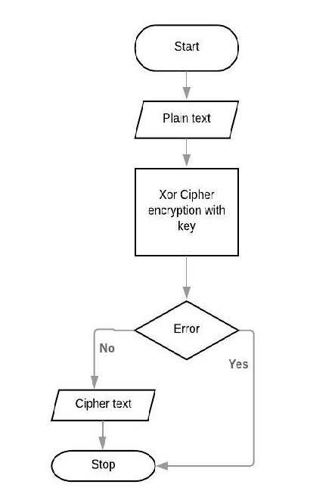
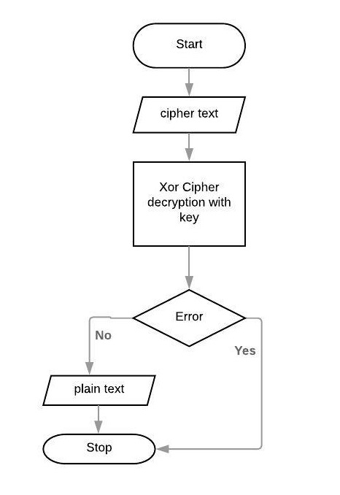
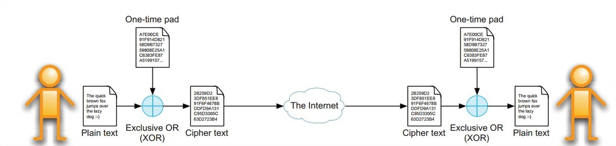
Methodology(cont)
Flow Chart of Encryption and Decryption

Slide 12
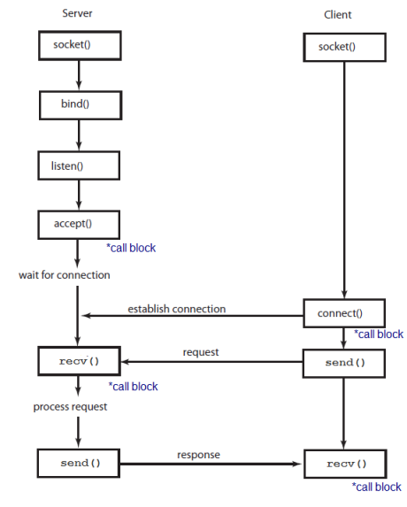
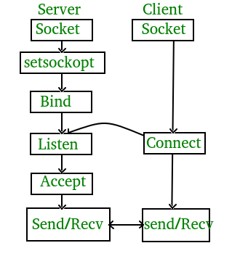
Methodology(cont)
TCP-IP Socket
Socket Server connection with client

Slide 13
Methodology(cont)
Client Algorithm :
Assign a file descriptor to a socket for client communication.
Connect request is then sent to the server. If any server is listening and has a free queue space for accepting a client it will accept the connection request.
Data is requested from the server.
Data is then sent by server and the connection is then terminated by closing the client socket file descriptor.

Slide 14
Methodology(cont)
Server Algorithm :
Server define a socket descriptor where communication will occur.
Gets an address and bind it to that socket to start listening for data requests on that socket.
Listen for any incoming data request from clients.
When a request arrives, insert its socket file descriptor in a queue and fulfill requests in the queue order. This is also known as accepting the request.
While sending data to one client, the socket is blocked for any other client request. When connected to a client data is sent.
The socket is then unblocked and available for the next request in the queue.

Slide 15
Methodology(cont)
Multiple client handling Algorithm :
Reap all dead processes so as to eliminate process signal crashes when client exits.
‘accept()’ function is considered as a parent process. When a client request arrives ‘fork()’ function is called and a child process is created for the same.
Listener socket is then deleted since not required by the child process.
The data is sent on the socket of the new created child socket using send().
When data is sent the socket is then closed since parent does not require this socket.
When the child process exits a signal is sent by wait() function to the parent process.
When parent receives the exit signal, it knows that current client has disconnected and accepts the next client for connection.

Slide 16
Function Prototype
Server -
int sockfd = socket(domain, type, protocol)
int setsockopt(int sockfd, int level, int optname,const void *optval, socklen_t optlen);
int bind(int sockfd, const struct sockaddr *addr,socklen_t addrlen);
int listen(int sockfd, int backlog);
int new_socket= accept(int sockfd, struct sockaddr *addr, socklen_t *addrlen);
Client-
<socket() prototype is same as server>
int connect(int sockfd, const struct sockaddr *addr, socklen_t addrlen);

Slide 17
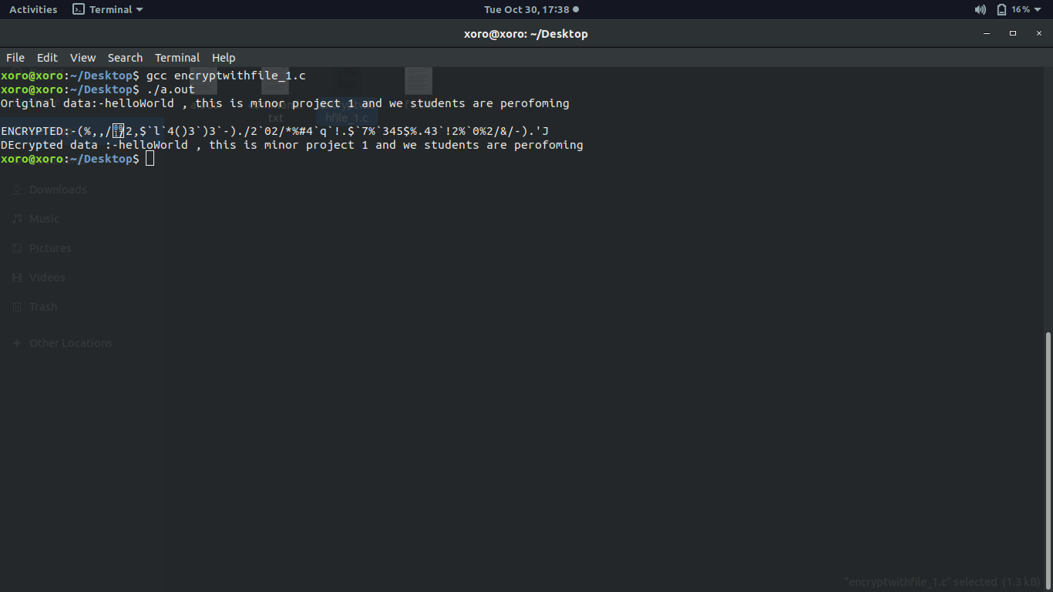
Screenshots
Encryption and Decryption Using XOR cipher Algorithm

Slide 18
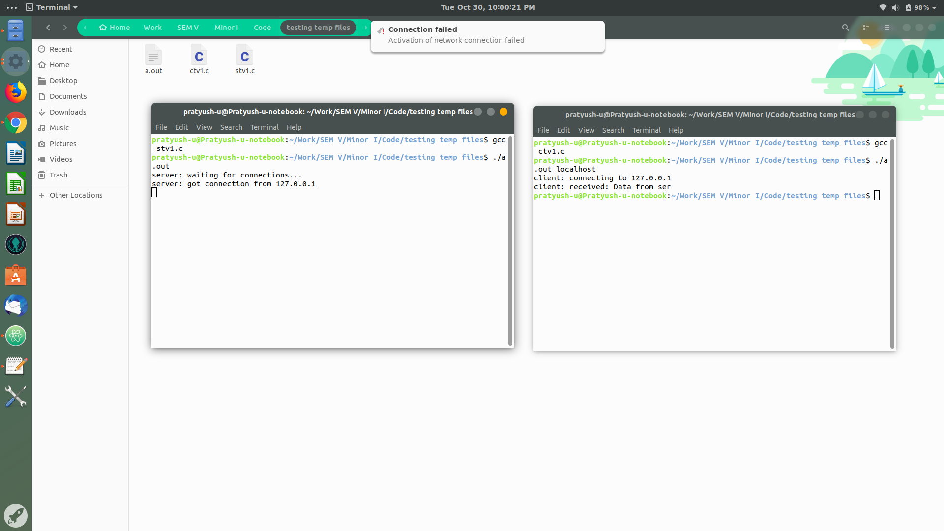
Screenshots
Client Server Architecture

